Slide 1

LeafLens
Bridging traditional knowledge with cutting-edge technology to preserve India's botanical heritage

Slide 2

LeafLens: Bridging Traditional Knowledge with Cutting-Edge Technology
Preserving the heritage of Indian medicinal plants and Fruit bearing plants and trees using AI and Machine Learning
Team Members
Dishubbh Singh (S24CSEU0808)
G. Ramanjaneya Reddy (S24CSEU0787)
Divya Kumar (S24CSEU0857)
Faculty Guide: Susmita Das

Slide 3
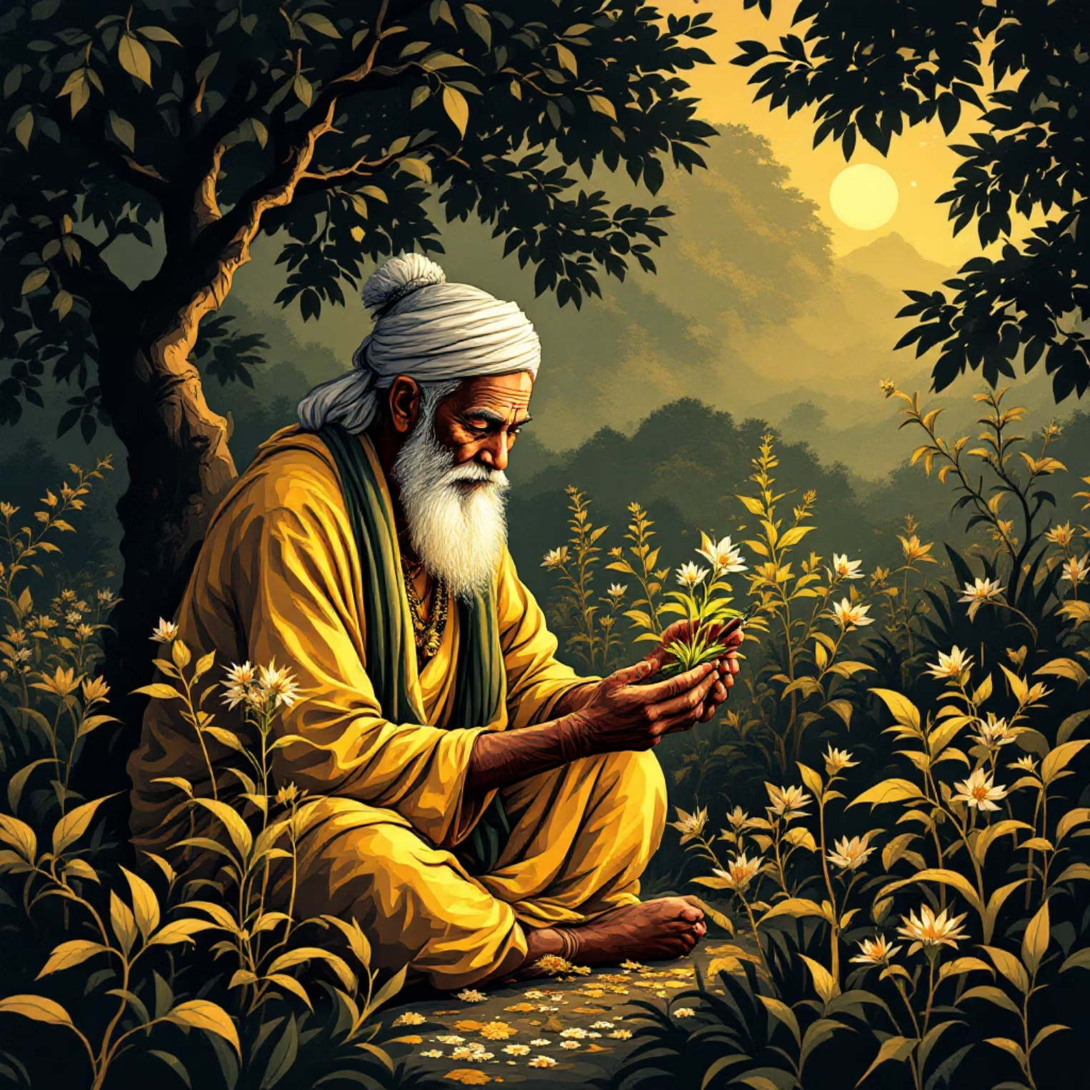
Problem Statement
Traditional medicinal plant knowledge in India faces a critical preservation crisis. Centuries of accumulated wisdom are disappearing at an alarming rate, threatening our cultural and scientific heritage.
Biodiversity Loss
Rapid environmental degradation and aging practitioners are causing irreplaceable knowledge to vanish with each passing generation.
Scattered Data Sources
Traditional knowledge remains fragmented across non-digitized manuscripts, oral traditions, and isolated communities.
Expert Dependency
Manual plant identification requires years of specialized training, limiting accessibility and scalability.
We need a smart system to digitize, identify, and preserve this ancient plant knowledge for future generations.

Slide 4
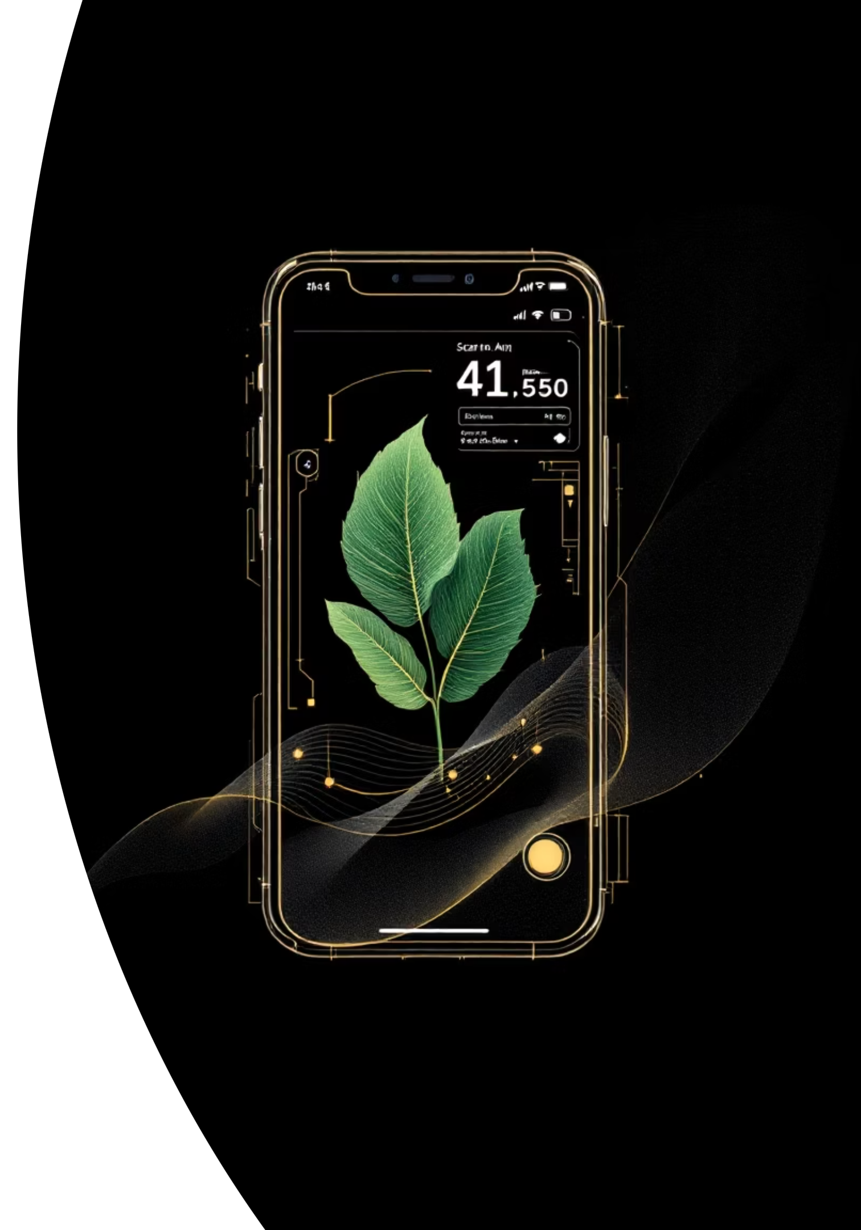



Proposed Solution
LeafLens develops an AI/ML-based plant identification system that transforms how we recognize and preserve medicinal plant knowledge. By leveraging deep learning and computer vision, we're creating a bridge between traditional botanical wisdom and modern technology.
Automated Recognition
Knowledge Integration
Deep learning models instantly identify plant species from leaf images with expert-level accuracy.
Visual recognition connects seamlessly with comprehensive medicinal plant databases containing traditional uses and properties.
Universal Accessibility
Information becomes instantly available to researchers, farmers, students, and healthcare practitioners worldwide.

Slide 5
Goals and Objectives
01
02
Automatic Plant Species Recognition
Traditional Medicinal Data Integration
Build a robust deep learning model capable of accurately identifying medicinal plant species from leaf images across diverse environmental conditions.
Create a comprehensive database linking identified species with their traditional medicinal uses, preparation methods, and cultural significance.
03
04
Accuracy, Accessibility, and Scalability
Digital Preservation of Indigenous Knowledge
Ensure the system delivers high-precision results while remaining accessible to users with varying technical expertise and scalable to accommodate expanding datasets.
Promote the long-term conservation of indigenous botanical wisdom by creating a sustainable digital archive accessible to future generations.

Slide 6
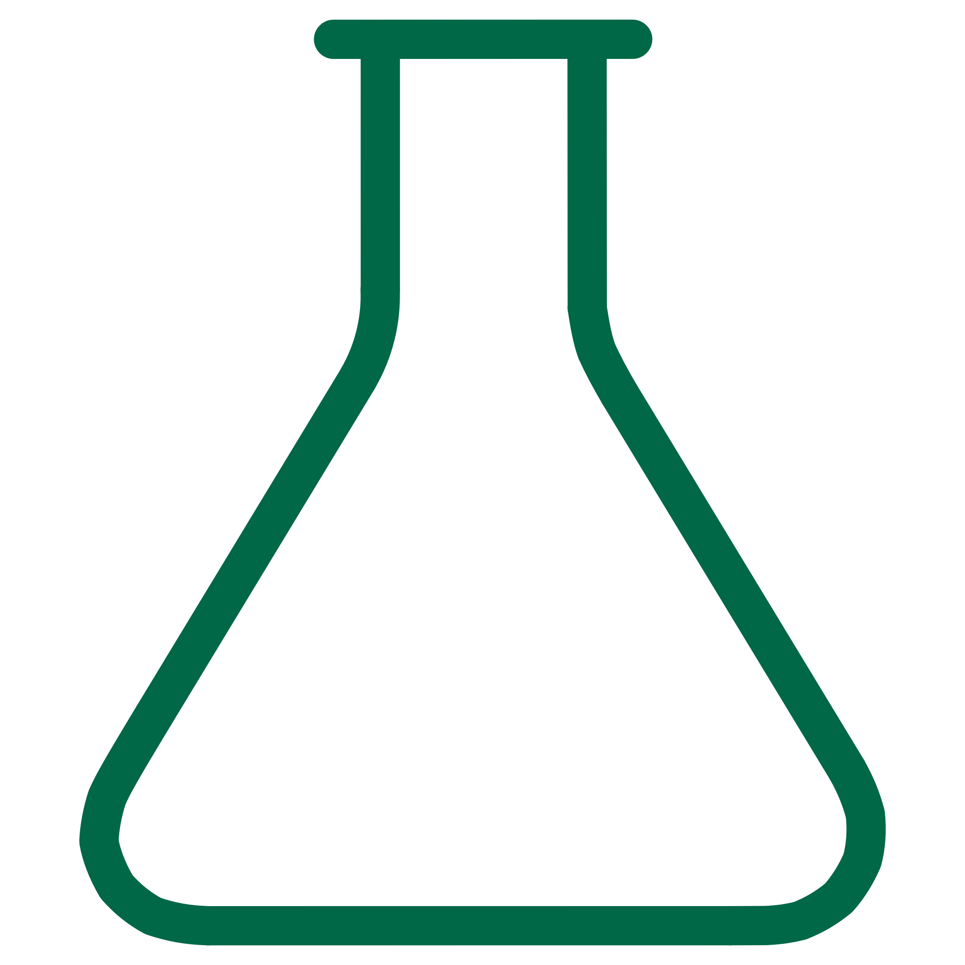



Technology Stack
Python
Core programming language providing extensive libraries for machine learning and data processing.
Tourch & Keras
Industry-leading deep learning frameworks enabling efficient model development and training.
Flask
Advanced computer vision library for sophisticated image preprocessing and analysis.
Deep Learning Models
MobileNet: Efficient model for mobile deployment
CNN: Custom convolutional neural network architecture
Xception: Advanced architecture for maximum accuracy
Development Tools
Jupyter Notebook: Interactive development environment
Kaggle Dataset: High-quality plant image repository

Slide 7




Data Structures and Algorithms
LeafLens leverages sophisticated data structures and cutting-edge algorithms to achieve optimal performance and accuracy in plant identification.
Data Structures
Core Algorithms
Arrays & Tensors
Convolutional Neural Networks
Multi-dimensional structures storing image pixel data and model parameters for efficient computation.
Extract hierarchical features from leaf images through specialized convolutional layers.
DataFrames
Transfer Learning
Organized tabular data management for plant species metadata and medicinal information.
Leverage pre-trained MobileNet and Xception models for enhanced accuracy with limited data.
Dictionaries
Image Augmentation
Fast key-value storage for species labels, medicinal properties, and model configurations.
Generate diverse training samples through rotation, scaling, and color adjustments.
Optimization
Adam optimizer with Softmax classification for precise species prediction.

Slide 8
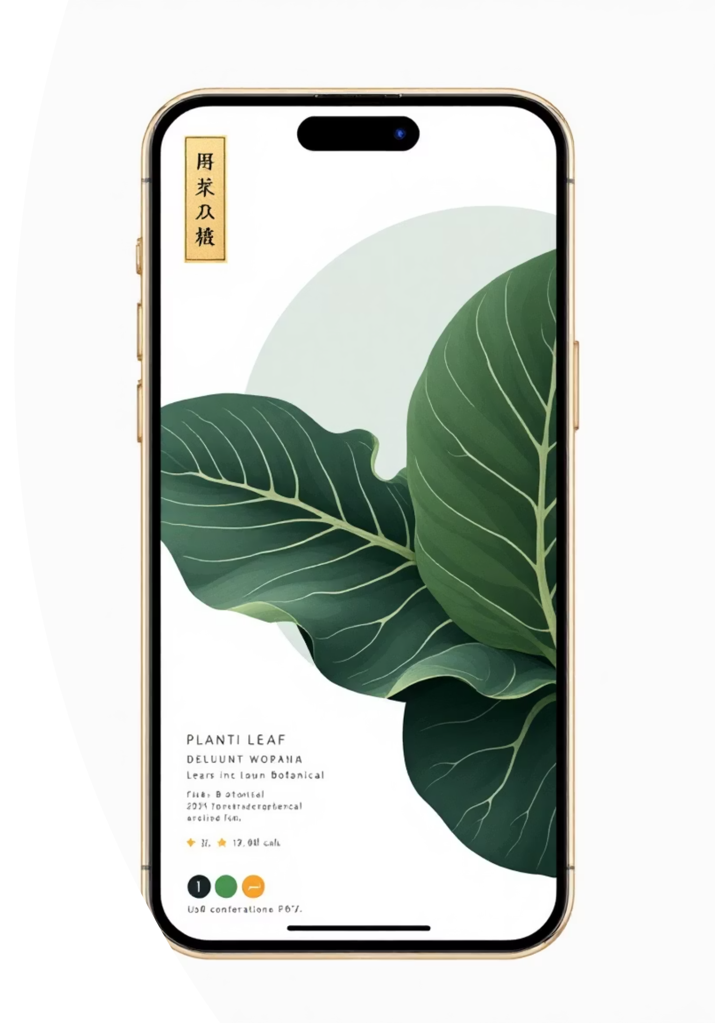
Key Features of LeafLens
🌿 Automated Leaf Recognition
📸 Real-time Image Processing
Instant species identification using state-of-the-art deep learning algorithms trained on thousands of medicinal plant images.
Lightning-fast analysis and classification of leaf images with immediate results and confidence scores.
📚 Traditional Medicine Database
Comprehensive integration with extensive medicinal properties, traditional uses, and preparation methods.
🔍 High-Accuracy Transfer Learning
Leverages pre-trained models achieving superior accuracy even with limited training data.
📱 Mobile App Deployment
Lightweight architecture optimized for smartphones enables field identification anywhere, anytime.

Slide 9
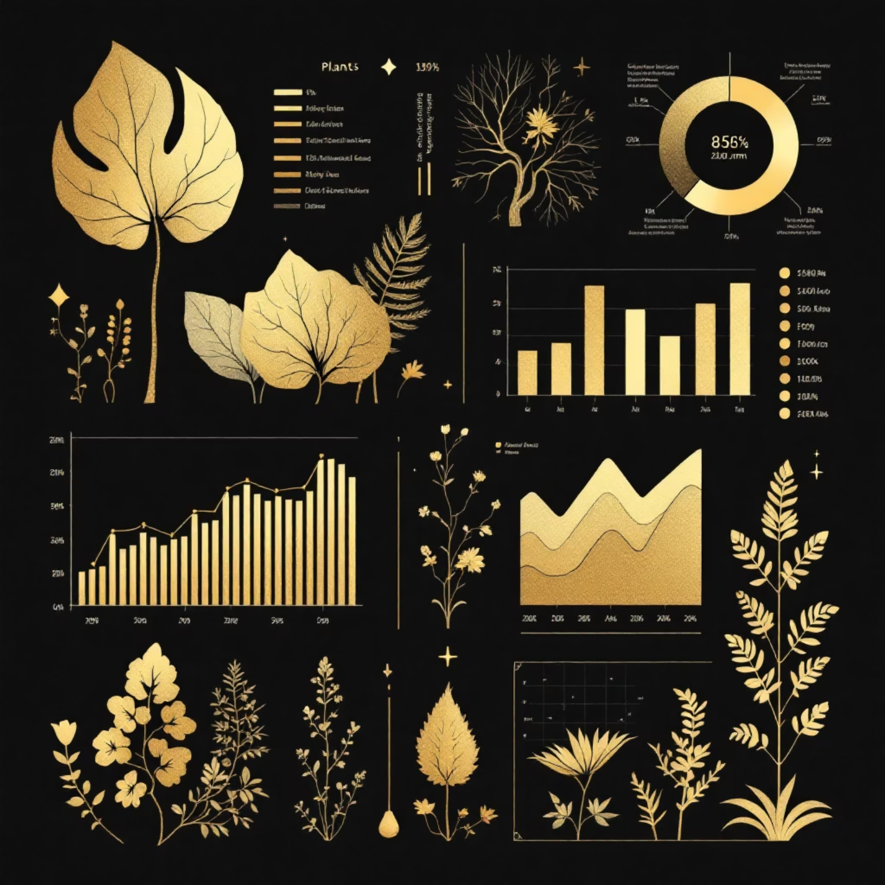
Results and Analysis
LeafLens demonstrates exceptional performance across multiple evaluation metrics, validating its effectiveness as a reliable tool for medicinal plant identification.
>97%
20+ For now
95%
Classification Accuracy
Species Recognized
Expert Validation
Achieved expert-level precision in identifying plant species across diverse datasets.
Comprehensive coverage of medicinal plants from across the Indian subcontinent.
Confirmed accuracy by professional botanists and traditional medicine practitioners.
Key Performance Highlights
Environmental Robustness: The model performs consistently across varying lighting conditions, backgrounds, and leaf orientations.
Augmentation Success: Dataset diversity enhancement through augmentation techniques significantly improved generalization capabilities.
Real-world Testing: Field validation confirms reliable performance in authentic environmental conditions.
Continuous Improvement: Regular model updates incorporate new species and refine accuracy based on user feedback.

Slide 10
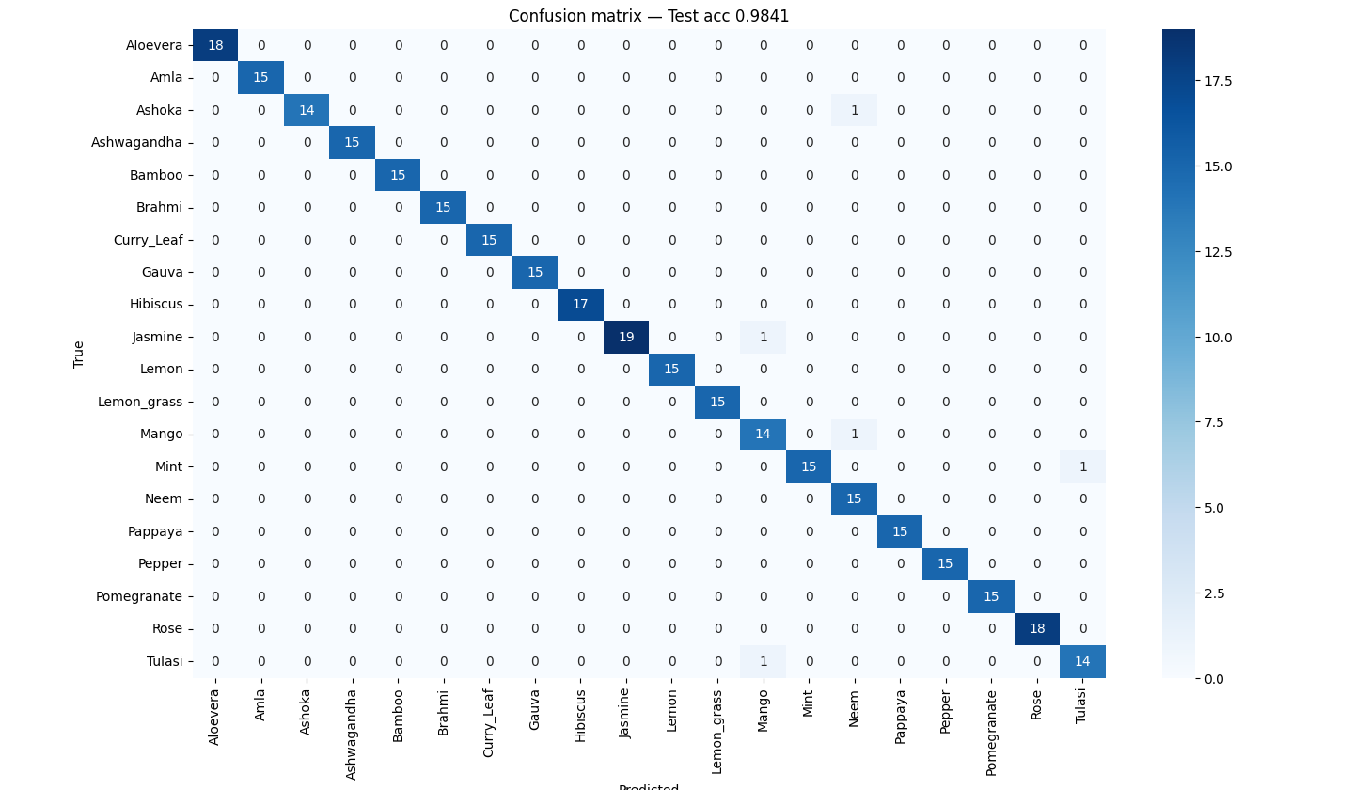

Slide 11




Future Prospects
LeafLens represents just the beginning of a transformative journey in botanical knowledge preservation and accessibility. Our vision extends far beyond current capabilities.
IoT-Based Smart Agriculture
Global Medicinal Plant Integration
Integrate with IoT sensors and drones for large-scale crop monitoring, enabling precision agriculture and sustainable farming practices.
Expand the database to encompass medicinal plants from diverse global traditions including Chinese, African, and South American botanical systems.
Real-time Mobile Field Scanning
Healthcare System Integration
Deploy advanced mobile applications with offline capabilities, enabling botanists, farmers, and researchers to identify plants instantly in remote locations.
Collaborate with medical institutions to support natural medicine research, drug discovery, and evidence-based herbal treatment protocols.
Together, we're preserving centuries of wisdom while pioneering the future of botanical science and sustainable healthcare.

